Slide 1
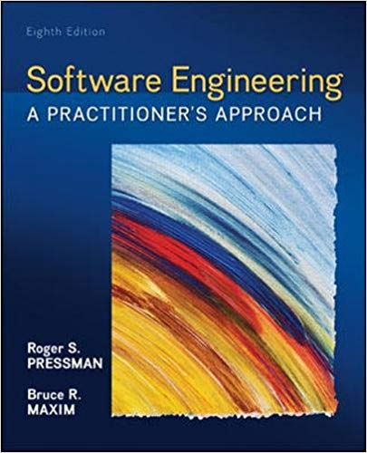
Requirement Analysis
CS46 Software Engineering
Dr. Shilpa chaudhari
Department of Computer Science and Engineering RIT, Bangalore

Slide 2
Outline of Session-2
Understanding Requirements: Requirements Engineering, Eliciting Requirements, Developing Use Cases, Building the Analysis Model, Negotiating Requirements, Requirements Monitoring, Validating Requirements, Avoiding Common Mistakes.
8.1, 8.3, 8.4, 8.5 8.6, 8.9
Scenario-Based Requirements Modeling: Requirements Analysis, Scenario-Based Modeling, UML Models That Supplement the Use Case.
9.1, 9.2, 9.3
Requirements Modeling for Web and Mobile Apps
11.5
Applying requirement engineering on the same case study of Unit-1.

Slide 3
Understanding Requirements

Slide 4
The Problems with our Requirements Practices
We have trouble understanding the requirements that we do acquire from the customer
We often record requirements in a disorganized manner
We spend far too little time verifying what we do record
We allow change to control us, rather than establishing mechanisms to control change
Most importantly, we fail to establish a solid foundation for the system or software that the user wants built

Slide 5
The Problems with our Requirements Practices
Many software developers argue that
Building software is so compelling that we want to jump right in (before having a clear understanding of what is needed)
Things will become clear as we build the software
Project stakeholders will be able to better understand what they need only after examining early iterations of the software
Things change so rapidly that requirements engineering is a waste of time
The bottom line is producing a working program and that all else is secondary
All of these arguments contain some truth, especially for small projects that take less than one month to complete
However, as software grows in size and complexity, these arguments begin to break down and can lead to a failed software project

Slide 6
A Solution: Requirements Engineering
Begins during the communication activity and continues into the modeling activity
Allows the requirements engineer to examine
the context of the software work to be performed
the specific needs that design and construction must address
the priorities that guide the order in which work is to be completed
the information, function, and behavior that will have a profound impact on the resultant design
The requirements engineering process can be described in seven distinct steps:
Inception
Elicitation
Elaboration
Negotiation
Specification
Validation
Requirements Management

Slide 7
Requirements Engineering Tasks
Inception—ask a set of questions that establish …
basic understanding of the problem
the people who want a solution
the nature of the solution that is desired, and
the effectiveness of preliminary communication and collaboration between the customer and the developer
Elicitation—elicit requirements from all stakeholders
Elaboration—create an analysis model that identifies data, function and behavioral requirements
Negotiation—agree on a deliverable system that is realistic for developers and customers

Slide 8
Requirements Engineering Tasks
Specification—can be any one (or more) of the following:
A written document
A set of models
A formal mathematical
A collection of user scenarios (use-cases)
A prototype
Validation—a review mechanism that looks for
errors in content or interpretation
areas where clarification may be required
missing information
inconsistencies (a major problem when large products or systems are engineered)
conflicting or unrealistic (unachievable) requirements.
Requirements management

Slide 9
Requirements Engineering Tasks
Some of these tasks may occur in parallel and all are adapted to the needs of the project
All strive to define what the customer wants
All serve to establish a solid foundation for the design and construction of the software

Slide 10
Establishing the Groundwork
During inception, the requirements engineer asks a set of questions to establish…
– A basic understanding of the problem
– The people who want a solution
– The nature of the solution that is desired
– The effectiveness of preliminary communication and collaboration between the customer and the developer
Through these questions, the requirements engineer needs to…
– Identify the stakeholders
– Recognize multiple viewpoints
– Work toward collaboration
– Break the ice and initiate the communication –ask Questions
– Nonfunctional requirements
– traceability

Slide 11
Establishing the Groundwork
Identify the stakeholders - business operations managers, product managers, marketing people, internal and external customers, end users consultants, product engineers, software engineers, support and maintenance engineers
Each stakeholder has a different view of the system, achieves different benefits when the system is successfully developed, and is open to different risks if the development effort should fail
Recognizing Multiple Viewpoints - requirements of the system will be explored from many different points of view each stakeholder - emerging requirements may be inconsistent or may conflict with one another
You should categorize all stakeholder information in a way that will allow decision makers to choose an internally consistent set of requirements for the system.

Slide 12
Establishing the Groundwork
Working toward Collaboration: Customers must collaborate among themselves and with software engineering practitioners if a successful system is to result
The job of a requirements engineer is to identify areas of commonality and areas of conflict or inconsistency
Collaboration does not necessarily mean that requirements are defined by committee
In many cases, stakeholders collaborate by providing their view of requirements, but a strong “project champion” may make the final decision about which requirements make the cut

Slide 13
Establishing the Groundwork
The First Set of Questions - focus on the customer, other stakeholders, the overall goals, and the benefits
Who is behind the request for this work?
Who will use the solution?
What will be the economic benefit of a successful solution?
Is there another source for the solution that you need?

Slide 14
Establishing the Groundwork
The Next Set of Questions - enable the requirements engineer to gain a better understanding of the problem and allow the customer to voice his or her perceptions about a solution
How would you characterize "good" output that would be generated by a successful solution?
What problem(s) will this solution address?
Can you show me (or describe) the business environment in which the solution will be used?
Will special performance issues or constraints affect the way the solution is approached?

Slide 15
Establishing the Groundwork
The Final Set of Questions - focus on the effectiveness of the communication activity itself
Are you the right person to answer these questions? Are your answers "official"?
Are my questions relevant to the problem that you have?
Am I asking too many questions?
Can anyone else provide additional information?
Should I be asking you anything else?
These questions will help to “break the ice” and initiate the communication that is essential to successful elicitation

Slide 16
Establishing the Groundwork
Non-Functional Requirements
Non-Functional Requirement (NFR) – quality attribute, performance attribute, security attribute, or general system constraint.
A two phase process is used to determine which NFR’s are compatible:
The first phase is to create a matrix using each NFR as a column heading and the system SE guidelines a row labels
The second phase is for the team to prioritize each NFR using a set of decision rules to decide which to implement by classifying each NFR and guideline pair as complementary, overlapping, conflicting, or independent

Slide 17
Establishing the Groundwork
Traceability - refers to documented links between software engineering work products
A traceability matrix allows a requirements engineer to represent the relationship between requirements and other software engineering work products (Rows - requirement names while columns - software engineering work product)

Slide 18
Eliciting Requirements
Requirements elicitation combines elements of problem solving, elaboration, negotiation, and specification
Elicitation may be accomplished through two activities
Collaborative requirements gathering
Quality function deployment

Slide 19
Eliciting Requirements - Collaborative Requirements Gathering
Meetings are conducted and attended by both software engineers, customers, and other interested stakeholders
Rules for preparation and participation are established
An agenda is suggested that is formal enough to cover all important points but informal enough to encourage the free flow of ideas
A "facilitator" (customer, developer, or outsider) controls the meeting
A "definition mechanism" is used such as work sheets, flip charts, wall stickers, electronic bulletin board, chat room, or some other virtual forum
The goal is to identify the problem, propose elements of the solution, negotiate different approaches, and specify a preliminary set of solution requirements

Slide 20
Eliciting Requirements - Collaborative Requirements Gathering
A one- or two-page “product request” is generated during inception
A meeting place, time, and date are selected
a facilitator is chosen; and attendees from the software team and other stakeholder organizations are invited to participate
The product request is distributed to all attendees before the meeting date

Slide 21
Case Study : SafeHome
Product request written by a marketing person involved in the SafeHome
Our research indicates that the market for home management systems is growing at a rate of 40 percent per year. The first SafeHome function we bring to market should be the home security function. Most people are familiar with “alarm systems” so This would be an easy sell.
The home security function would protect against and/or recognize a variety of undesirable “situations” such as illegal entry, fire, flooding, carbon monoxide levels, and others. It’ll use our wireless sensors to detect each situation, can be programmed by the homeowner, and will automatically telephone a monitoring agency when a situation is detected. e project

Slide 22
Case Study : SafeHome
While reviewing the product request in the days before the meeting, each attendee is asked to make a list of objects that are part of the environment that surrounds the system, other objects that are to be produced by the system, and objects that are used by the system to perform its functions

Slide 23
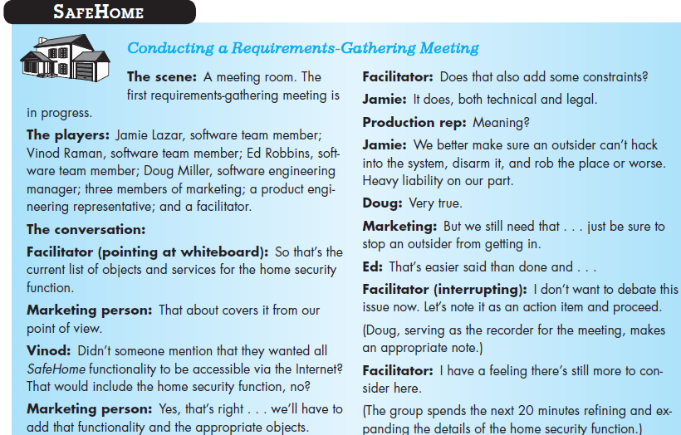

Slide 24
Eliciting Requirements - Quality Function Deployment
This is a technique that translates the needs of the customer into technical requirements for software
It emphasizes an understanding of what is valuable to the customer and then deploys these values throughout the engineering process through functions, information, and tasks
It identifies three types of requirements
Normal requirements: These requirements are the objectives and goals stated for a product or system during meetings with the customer
Expected requirements: These requirements are implicit to the product or system and may be so fundamental that the customer does not explicitly state them
Exciting requirements: These requirements are for features that go beyond the customer's expectations and prove to be very satisfying when present

Slide 25
Eliciting Requirements - Usage Scenarios
how these functions and features will be used by different classes of end users?
developers and users can create a set of scenarios (use cases) that identify a thread of usage for the system to be constructed

Slide 26
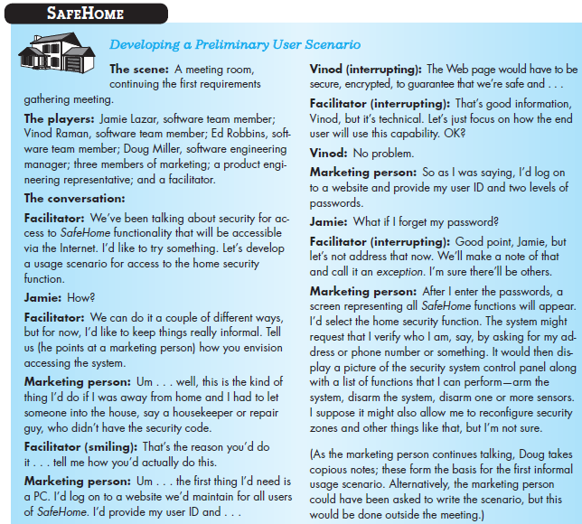

Slide 27
Eliciting Requirements - Work Products
Vary depending on the size of the system or product to be built but should include one or more of the following items
a statement of need and feasibility.
a bounded statement of scope for the system or product.
a list of customers, users, and other stakeholders who participated in requirements elicitation
a description of the system’s technical environment.
a list of requirements (preferably organized by function) and the domain constraints that apply to each.
a set of usage scenarios that provide insight into the use of the system or product under different operating conditions.
any prototypes developed to better define requirements.

Slide 28
Eliciting Requirements - Agile Requirements Elicitation
All stakeholders asked to create user stories that describes a simple system requirement written from the user’s perspective
Often lacks overall business goals and nonfunctional requirements
rework is required to accommodate performance and security issues
user stories may not provide a sufficient basis for system evolution over time
Notes:
Within the context of an agile process, requirements are elicited by asking all stakeholders to create user stories . Each user story describes a simple system requirement written from the user’s perspective. User stories can be written on small note cards, making it easy for developers to select and manage a subset of requirements to implement for the next product increment. Proponents claim that using note cards written in the user’s own language allows developers to shift their focus to communication with stakeholders on the selected requirements rather than their own agenda [Mai10a].
Although the agile approach to requirements elicitation is attractive for many software teams, critics argue that a consideration of overall business goals and nonfunctional requirements is often lacking. In some cases, rework is required to accommodate performance and security issues. In addition, user stories may not provide a sufficient basis for system evolution over time

Slide 29
Eliciting Requirements - Service-Oriented Methods
views a system as an aggregation of services
service design methods emphasize understanding the customer, thinking creatively, and building solutions quickly
focuses on the definition of services to be rendered by an application
Notes:
Service-oriented development views a system as an aggregation of services. A service can be “as simple as providing a single function, for example, a request/
response-based mechanism that provides a series of random numbers, or can be an aggregation of complex elements, such as the Web service API” [Mic12].
Requirements elicitation in service-oriented development focuses on the definition of services to be rendered by an application. As a metaphor, consider
the service provided when you visit a fine hotel. A doorperson greets guests. A valet parks their cars. The desk clerk checks the guests in. A bellhop manages
the bags. The concierge assists guest with local arrangements. Each contact or touchpoint between a guest and a hotel employee is designed to enhance the
hotel visit and represents a service offered.
Most service design methods emphasize understanding the customer, thinking creatively, and building solutions quickly [Mai10b]. To achieve these goals,
requirements elicitation can include ethnographic studies, 11 innovation workshops, and early low-fidelity prototypes. Techniques for eliciting requirements
must also acquire information about the brand and the stakeholders’ perceptions of it. In addition to studying how the brand is used by customers, analysts
need strategies to discover and document requirements about the desired qualities of new user experiences. User stories are helpful in this regard.
The requirements for touchpoints should be characterized in a manner that indicates achievement of the overall service requirements. This suggests that
each requirement should be traceable to a specific service.

Slide 30
Elaboration Task
During elaboration, the software engineer takes the information obtained during inception and elicitation and begins to expand and refine it
Elaboration focuses on developing a refined technical model of software functions, features, and constraints
It is an analysis modeling task
Use cases are developed
Domain classes are identified along with their attributes and relationships
State machine diagrams are used to capture the life on an object
The end result is an analysis model that defines the functional, informational, and behavioral domains of the problem

Slide 31
Developing Use Cases
A Use case represents the functionality of the system.
A collection of user scenarios that describe the thread of usage of a system
Each scenario is described from the point-of-view of an “actor
Step One – Define the set of actors that will be involved in the story
Actors are people, devices, or other systems that use the system or product within the context of the function and behavior that is to be described
Actors are anything that communicate with the system or product and that are external to the system itself
Primary actors interact to achieve required system function and derive the intended benefit from the system - They work directly and frequently with the software
Secondary actors support the system so that primary actors can do their work.
Step Two – Develop use cases, where each one answers a set of questions

Slide 32
Developing Use Cases
Each scenario answers the following questions:
Who is the primary actor, the secondary actor (s)?
What are the actor’s goals?
What preconditions should exist before the story begins?
What main tasks or functions are performed by the actor?
What extensions might be considered as the story is described?
What variations in the actor’s interaction are possible?
What system information will the actor acquire, produce, or change?
Will the actor have to inform the system about changes in the external environment?
What information does the actor desire from the system?
Does the actor wish to be informed about unexpected changes?

Slide 33
Example: SafeHome

Slide 34
SafeHome - Actor
Four actors:
Homeowner (a user)
setup manager (likely the same person as homeowner, but playing a different role)
sensors (devices attached to the system)
the monitoring and response subsystem (the central station that monitors the SafeHome home security function).

Slide 35
SafeHome - homeowner Actor
enters a password to allow all other interactions,
inquires about the status of a security zone,
(3) inquires about the status of a sensor,
(4) presses the panic button in an emergency,
(5) activates/deactivates the security system.
basic use case presents a high-level story that describes the interaction between the actor and the system

Slide 36
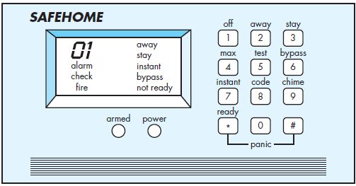

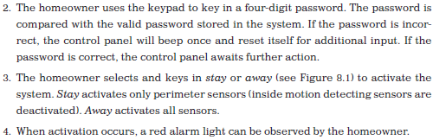
SafeHome - homeowner uses the control panel
basic use case for system activation follows

Slide 37
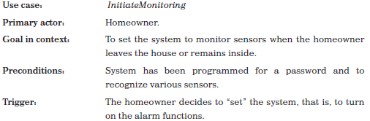
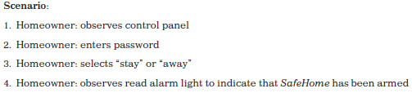
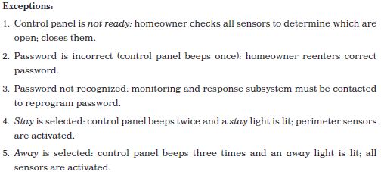
SafeHome - homeowner uses the control panel
uses cases are further elaborated to provide considerably more detail about the interaction

Slide 38
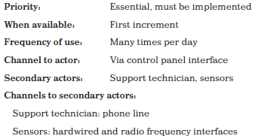
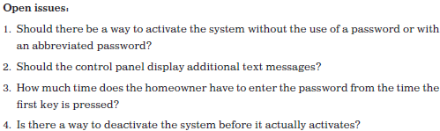
SafeHome - homeowner uses the control panel
Use cases for other homeowner interactions would be developed in a similar manner

Slide 39
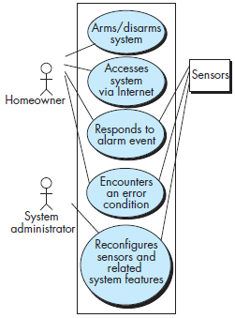
Use Case Diagram for SafeHome
UML use case diagram for SafeHome home security function

Slide 40
Building the Analysis Model
Analysis model provides a description of the required informational, functional, and behavioral domains for a computer-based system
approach to build analysis model should have a higher probability of uncovering omissions, inconsistencies, and ambiguity
Description of analysis model and the methods that are used to build it includes
Elements of the Analysis Model
Analysis Patterns
Agile Requirements Engineering
Requirements for Self-Adaptive Systems

Slide 41
Elements of the Analysis Model
Scenario-based elements- Describe the system from the user's point of view using scenarios that are depicted in use cases and activity diagrams
Functional—processing narratives for software functions
Use-case—descriptions of the interaction between an “actor” and the system
Class-based elements- Implied by scenarios
Identify the domain classes for the objects manipulated by the actors, the attributes of these classes, and how they interact with one another; they utilize class diagrams to do this
Behavioral elements - Use state diagrams to represent the state of the system, the events that cause the system to change state, and the actions that are taken as a result of a particular event; can also be applied to each class in the system
Flow-oriented elements - Use data flow diagrams to show the input data that comes into a system, what functions are applied to that data to do transformations, and what resulting output data are produced

Slide 42
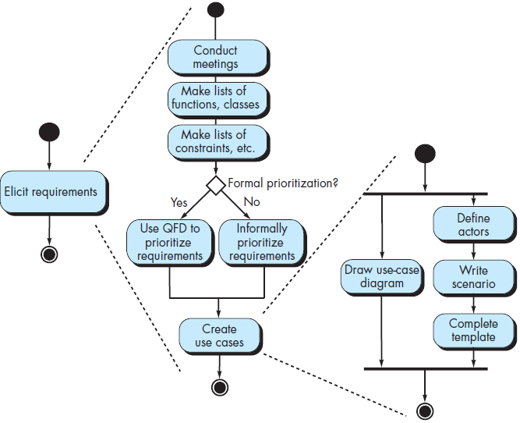
Scenario-based elements
serve as input for the creation of other modeling elements
UML activity diagrams for eliciting requirements and representing them using use cases.

Slide 43
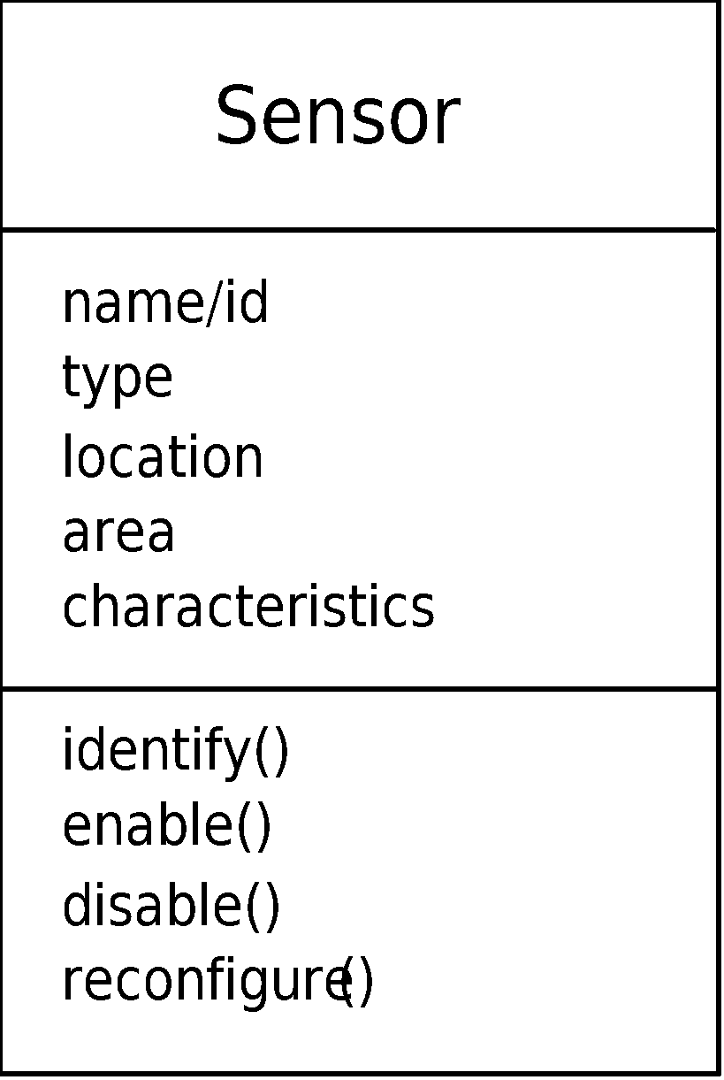
Class-based elements
depict the manner in which classes collaborate with one another and the relationships and interactions between classes
From the SafeHome system …

Slide 44
Behavioral elements
behavioral representations of the system as a whole
Behavior of individual classes
Simple UML state diagram
Reading
Commands
State name
System status = “ready”
Display msg = “enter cmd”
Display status = steady
State variables
Entry/subsystems ready
Do: poll user input panel
Do: read user input
Do: interpret user input
State activities

Slide 45
Different mode of representation
User view
Use case diagram
Structural view Class diagram Object diagram
Behavioral view Sequence diagram State diagram Collaboration diagram
Implementation view Component diagram
Environment view Deployment diagram

Slide 46
Analysis Patterns
If you want to obtain solutions to customer requirements more rapidly and provide your team with proven approaches, use analysis patterns.
Benefits
speed up the development of abstract analysis models
facilitate the transformation of the analysis model into a design model by suggesting design patterns and reliable solutions for common problems

Slide 47
Agile Requirements Engineering
transfer ideas from stakeholders to the software team rather than create extensive analysis work products
allows the early creation and testing of working prototypes
addresses important issues
high requirements volatility
incomplete knowledge of development technology
customers not able to articulate their visions until they see a working prototype

Slide 48
Requirements for Self-Adaptive Systems
Self-adaptive systems can
reconfigure themselves
augment their functionality
protect themselves
recover from failure
accomplish all of this while hiding most of their internal complexity from their users
document the variability needed for self-adaptive systems include
timing uncertainty
user profile differences (e.g., end users versus systems administrators)
behavior changes based on problem domain (e.g., commercial or educational)
or pre-defined behaviors exploiting system assets
More variability increases complexity

Slide 49
Negotiating Requirements
develop a project plan that meets stakeholder needs while at the same time reflecting the real-world constraints (e.g., time, people, budget) that have been placed on the software team
set of negotiation activities
Identify the key stakeholders
These are the people who will be involved in the negotiation
Determine each of the stakeholders “win conditions”
Win conditions are not always obvious
Negotiate
Work toward a set of requirements that lead to “win-win”
Notes:
win-win” - stakeholders win by getting the system or product that satisfies the majority of their needs and you (as a member of the software team) win by working to realistic and achievable budgets and deadlines.

Slide 50
Negotiating Requirements
Handshaking - tends to improve identification, analysis, and selection of variants and promotes win-win negotiation
the software team
proposes solutions to requirements
describes their impact
communicates their intentions to customer representatives.
customer representatives
review the proposed solutions, focusing on missing features
seeking clarification of novel requirements

Slide 51
Guidelines to negotiate effectively
Recognize that it’s not a competition. To be successful, both parties have to feel they’ve won or achieved something. Both will have to compromise.
Map out a strategy. Decide what you’d like to achieve, what the other party wants to achieve, and how you’ll go about making both happen.
Listen actively. Don’t work on formulating your response while the other party is talking. Listen to her. It’s likely you’ll gain knowledge that will help you to better negotiate your position.
Focus on the other party’s interests. Don’t take hard positions if you want to avoid conflict.
Don’t let it get personal. Focus on the problem that needs to be solved.
Be creative. Don’t be afraid to think out of the box if you’re at an impasse.
Be ready to commit. Once an agreement has been reached, don’t waffle; commit to it and move on.

Slide 52
Requirements Monitoring
Especially needes in incremental development that encompasses five tasks
Distributed debugging – uncovers errors and determines their cause.
Run-time verification – determines whether software matches its specification.
Run-time validation – assesses whether evolving software meets user goals.
Business activity monitoring – evaluates whether a system satisfies business goals.
Evolution and codesign – provides information to stakeholders as the system evolves.

Slide 53
Validating Requirements
A review of the requirements model addresses the following questions: to ensure that the requirements model is an accurate reflection of stakeholder needs and that it provides a solid foundation for design
Is each requirement consistent with the overall objective for the system/product?
Have all requirements been specified at the proper level of abstraction? That is, do some requirements provide a level of technical detail that is inappropriate at this stage?
Is the requirement really necessary or does it represent an add-on feature that may not be essential to the objective of the system?
Is each requirement bounded and unambiguous?

Slide 54
Validating Requirements
Does each requirement have attribution? That is, is a source (generally, a specific individual) noted for each requirement?
Do any requirements conflict with other requirements?
Is each requirement achievable in the technical environment that will house the system or product?
Is each requirement testable, once implemented?
Does the requirements model properly reflect the information, function and behavior of the system to be built.
Has the requirements model been “partitioned” in a way that exposes progressively more detailed information about the system.
Have requirements patterns been used to simplify the requirements model. Have all patterns been properly validated? Are all patterns consistent with customer requirements?

Slide 55
Avoiding Common Mistakes
Featuritis - the practice of trading functional coverage for overall system quality
Flexibilitis - happens when software engineers overload product with adaptation and configuration facilities
Performitis - occurs when software developers become overly focused on system performance at the expense of quality attributes like maintainability, reliability, or security

Slide 56
Scenario-Based Requirements Modeling

Slide 57
Requirements Analysis
Requirements analysis
specifies software’s operational characteristics
indicates software's interface with other system elements
establishes constraints that software must meet
Requirements analysis allows the software engineer (called an analyst or modeler in this role) to:
elaborate on basic requirements established during earlier requirement engineering tasks
build models that depict user scenarios, functional activities, problem classes and their relationships, system and class behavior, and the flow of data as it is transformed.

Slide 58
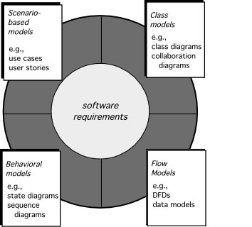
Elements of Requirements Analysis
Scenario-based - system from the user’s point of view
Data - shows how data are transformed inside the system
Class-oriented - defines objects, attributes, and relationships
Flow-oriented - shows how data are transformed inside the system
Behavioral - show the impact of events on the system states
Notes:
Requirements modeling action results in one or more
Scenario-based models - the point of view of various system “actors.”
Class-oriented models -object-oriented classes and the manner in which classes collaborate to achieve system requirements.
Behavioral and patterns-based models - software behavior as a consequence of external “events.”
Data models - information domain for the problem.
Flow-oriented models - functional elements of the system and how they transform data as they move through the system.

Slide 59
Requirement Analysis -Overall Objectives and Philosophy
Primary focus is on what, not how
What user interaction occurs in a particular circumstance
what objects does the system manipulate
what functions must the system perform
what behaviors does the system exhibit
what interfaces are defined
what constraints apply?
Requirements model must achieve three primary objectives:
(1) to describe what the customer requires
(2) to establish a basis for the creation of a software design, and
(3) to define a set of requirements that can be validated once the software is built.

Slide 60
Analysis Model - A Bridge
Analysis model bridges the gap between
a system- level description that describes overall system or business functionality as it is achieved by applying software, hardware, data, human, and other system elements
a software design that describes the software’s application architecture, user interface, and component-level structure

Slide 61
Analysis Model - Rules of Thumb
The model should focus on requirements that are visible within the problem or business domain. The level of abstraction should be relatively high.
Each element of the analysis model should add to an overall understanding of software requirements and provide insight into the information domain, function and behavior of the system.
Delay consideration of infrastructure and other non-functional models until design.
Minimize coupling throughout the system.
Be certain that the analysis model provides value to all stakeholders.
Keep the model as simple as it can be.

Slide 62
Analysis Model - Domain Analysis
Goal - to find or create the analysis classes and/or analysis patterns that are broadly applicable so that they may be reused
May be viewed as an umbrella activity for the software process
Software domain analysis is the identification, analysis, and specification of common requirements from a specific application domain, typically for reuse on multiple projects within that application domain . . . [Object-oriented domain analysis is] the identification, analysis, and specification of common, reusable capabilities within a specific application domain, in terms of common objects, classes, subassemblies, and frameworks . . .
Donald Firesmith
Notes:
Domain analysis helps to recognize the analysis patterns and classes reoccur across many applications within a specific business domain

Slide 63
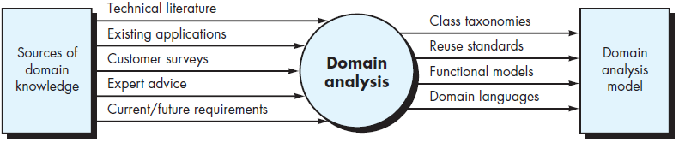
Domain Analysis
Role of the domain analyst -
Define the domain to be investigated.
Collect a representative sample of applications in the domain.
Analyze each application in the sample.
Develop an analysis model for the objects
Input and output for domain analysis

Slide 64
Requirements Modeling Approaches
structured analysis
considers data and the processes that transform the data as separate entities
Data objects are modeled in a way that defines their attributes and relationships.
Processes that manipulate data objects are modeled in a manner that shows how they transform data as data objects flow through the system.
object-oriented analysis
focuses on the definition of classes and the manner in which they collaborate with one another to effect customer requirements.
UML and the Unified Process are predominantly object oriented

Slide 65
Element of the requirements model
presents the problem from a different point of view
Notes:
Scenario-based elements depict how the user interacts with the system and the specific sequence of activities that occur as the software is used.
Class-based elements model the objects that the system will manipulate, the operations that will be applied to the objects to effect the manipulation, relationships (some hierarchical) between the objects, and the collaborations that occur between the classes that are defined.
Behavioral elements depict how external events change the state of the system or the classes that reside within it.
Finally, flow-oriented elements represent the system as an information transform, depicting how data objects are transformed as they flow through various system functions

Slide 66
Scenario-Based Modeling
How to measure success of a computer-based system or product?
Many ways, user satisfaction resides at the top of the list
requirements modeling with UML can be used to understand user satisfaction that begins with the creation of scenarios in the form of use cases, activity diagrams, and swimlane diagrams
We noted that a use case describes a specific usage scenario in straightforward language from the point of view of a defined actor.
Each use case is represented by an oval.
But how do you know (1) what to write about, (2) how much to write about it, (3) how detailed to make your description, and (4) how to organize the description?
Notes:
“[Use-cases] are simply an aid to defining what exists outside the system (actors) and what should be performed by the system (use-cases).” Ivar Jacobson
(1) What should we write about?
(2) How much should we write about it?
(3) How detailed should we make our description?
(4) How should we organize the description?

Slide 67
What to Write About?
Inception and elicitation—provide you with the information you’ll need to begin writing use cases.
Requirements gathering meetings, quality function deployment (QFD), and other requirements engineering mechanisms are used to
identify stakeholders
define the scope of the problem
specify overall operational goals
establish priorities
outline all known functional requirements, and
describe the things (objects) that will be manipulated by the system.
To begin developing a set of use cases, list the functions or activities performed by a specific actor.

Slide 68
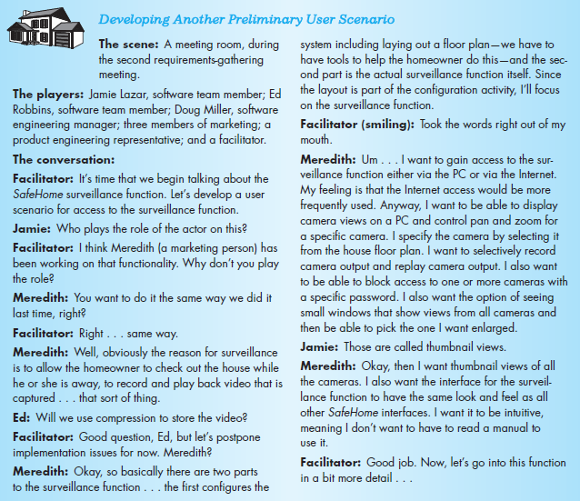

Slide 69
What to Write About?
SafeHome home surveillance function identifies the following functions that are performed by the homeowner actor
• Select camera to view.
• Request thumbnails from all cameras.
• Display camera views in a PC window.
• Control pan and zoom for a specifi c camera.
• Selectively record camera output.
• Replay camera output.
• Access camera surveillance via the Internet.
develop use cases for each of the functions noted in informal narrative fashion or in structured format.

Slide 70
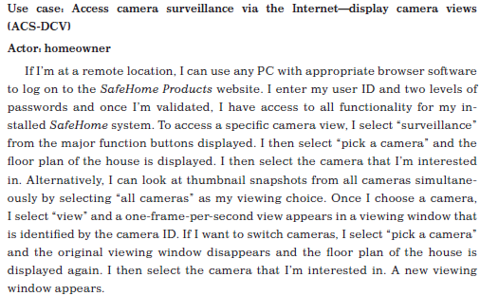
What to Write About?
stakeholder who takes on the role of the homeowner actor might write the following narrative for the function access camera surveillance via the Internet—display camera views ( ACS-DCV )

Slide 71
What to Write About?
Revisiting the ACS-DCV function as an ordered sequence of user actions
1. The homeowner logs onto the SafeHome Products website.
2. The homeowner enters his or her user ID.
3. The homeowner enters two passwords (each at least eight characters in length).
4. The system displays all major function buttons.
5. The homeowner selects the “surveillance” from the major function buttons.
6. The homeowner selects “pick a camera.”
7. The system displays the floor plan of the house.
8. The homeowner selects a camera icon from the floor plan.
9. The homeowner selects the “view” button.
10. The system displays a viewing window that is identified by the camera ID.
11. The system displays video output within the viewing window at one frame per second.

Slide 72
How Much to Write About?
As further conversations with the stakeholders progress, the requirements gathering team develops use cases for each of the functions noted.
In general, use cases are written first in an informal narrative fashion.
If more formality is required, the same use case is rewritten using a structured format similar to the one proposed.

Slide 73
Refining a Preliminary Use Case
Use-cases are written first in narrative form and mapped to a template if formality is needed
Each primary scenario should be reviewed and refined to see if alternative interactions are possible
Can the actor take some other action at this point?
Is it possible that the actor will encounter an error condition at some point? If so, what?
Is it possible that the actor will encounter some other behavior at some point? If so, what?
Each of the answer can be characterized as a use case exception.
An exception describes a situation (either a failure condition or an alternative chosen by the actor) that causes the system to exhibit somewhat different behavior

Slide 74
Refining a Preliminary Use Case
Explore following issues through “brainstorming” session to derive a reasonably complete set of exceptions for each use case
Are there cases in which some “validation function” occurs during this use case?
Eg .Occurrence of potential error condition
Are there cases in which a supporting function (or actor) will fail to respond appropriately?
Eg. Timeout for user action
Can poor system performance result in unexpected or improper user actions?
Eg. multiple selects on a processing button queue the requests inappropriately and ultimately generate an error condition

Slide 75
Refining a Preliminary Use Case- ACS-DCV
Revisiting the ACS-DCV function as an ordered sequence of user actions
1. The homeowner logs onto the SafeHome Products website.
2. The homeowner enters his or her user ID.
3. The homeowner enters two passwords (each at least eight characters in length).
4. The system displays all major function buttons.
5. The homeowner selects the “surveillance” from the major function buttons.
6. The homeowner selects “pick a camera.”
7. The system displays the floor plan of the house.
8. The homeowner selects a camera icon from the floor plan.
9. The homeowner selects the “view” button.
10. The system displays a viewing window that is identified by the camera ID.
11. The system displays video output within the viewing window at one frame per second.
Consider this

Slide 76
Refining a Preliminary Use Case- ACS-DCV
Can the actor take some other action at this point?
Yes –the actor may choose to view thumbnail snapshots of all cameras simultaneously
Secondary scenario might be “View thumbnail snapshots for all cameras.”
Is it possible that the actor will encounter some error condition at this point?
Floor plan with camera icons may have never been configured
Selecting “pick a camera” results in an error condition
Secondary Scenario - “No floor plan configured for this house.”
Is it possible that the actor will encounter some other behavior at this point?
Alarm condition would result in the system displaying a special alarm notification (type, location, system action) and providing the actor with a number of options relevant to the nature of the alarm
occur at any time for virtually all interactions
a separate use case— Alarm condition encountered —would be developed and referenced from other use cases as required

Slide 77
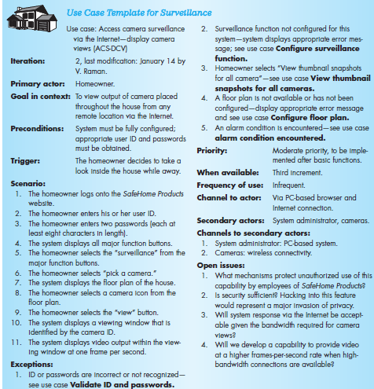
Writing a Formal Use Case
Desired when a use case involves a critical activity or describes a complex set of steps with a significant number of exceptions

Slide 78
Writing a Formal Use Case
goal in context identifies the overall scope of the use case
precondition describes what is known to be true before the use case is initiated.
trigger identifies the event or condition that “gets the use case started”
scenario lists the specific actions that are required by the actor and the appropriate system responses
Exceptions identify the situations uncovered as the preliminary use case is refined
Additional headings may or may not be included and are reasonably self-explanatory.

Slide 79
Use-Case Diagram

Slide 80
UML Models - Supplement Use Case
impart information in a clear and concise manner compare to text-based model
UML activity diagram supplements the use case by providing a graphical representation of the flow of interaction within a specific scenario
UML swimlane diagram
useful variation of the activity diagram
allows you to represent the flow of activities described by the use case
at the same time indicate which actor or analysis class has responsibility for the action described by an activity rectangle

Slide 81
Activity Diagram Notation
Rounded rectangles to imply a specific system function,
Arrows to represent flow through the system
Decision diamonds to depict a branching decision
each arrow emanating from the diamond is labeled
Solid horizontal lines to indicate that parallel activities are occurring

Slide 82
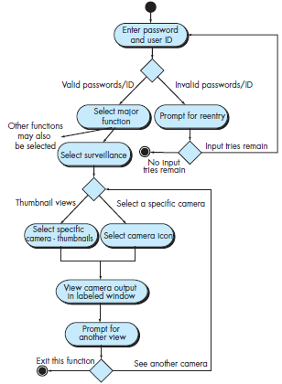
Activity diagram - ACS-DCV use case

Slide 83
Swimlane Diagrams
Responsibilities are represented as parallel segments that divide the diagram vertically, like the lanes in a swimming pool.
activity diagram is rearranged so that activities associated with a particular analysis class fall inside the swimlane for that class
Use cases, along with the activity and swimlane diagrams, are procedurally oriented
represent the manner in which various actors invoke specific functions (or other procedural steps) to meet the requirements of the system

Slide 84
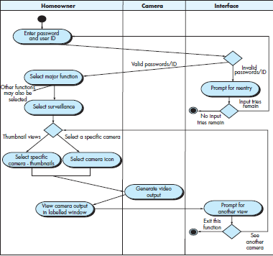
Swimlane Diagrams- ACS-DCV use case
Three analysis classes— Homeowner, Camera, and Interface

Slide 85
Class-Based Modeling
Class-based modeling represents:
objects that the system will manipulate
operations (also called methods or services) that will be applied to the objects to effect the manipulation
relationships (some hierarchical) between the objects
collaborations that occur between the classes that are defined.
The elements of a class-based model include classes and objects, attributes, operations, Class-responsibility-collaborator (CRC) models, collaboration diagrams and packages.
Notes:
This is just for SE continuity …not in the syllabus

Slide 86
Requirements Modeling for Web and Mobile Apps

Slide 87
WebApp and mobile developer
Agile development and analysis is time consuming
If WebApp and mobile developer understood the requirements of the problem or product then skip requirements modeling otherwise requirements modeling should be performed
How Much Analysis Is Enough?
The degree to which requirements modeling for WebApps are emphasized depends on the following factors:
• Size and complexity of WebApp increment.
• Number of stakeholders
• Size of the WebApp team.
• Degree to which members of the WebApp team have worked together before
• Degree to which the organization’s success is directly dependent on the success of the WebApp.
Notes:
How Much Analysis Is Enough?
depends on the following size-related factors:
(1) the size and complexity of the application increment
(2) the number of stakeholders (analysis can help to identify conflicting requirements coming from different sources),
(3) the size of the app development team,
(4) the degree to which members of the team have worked together before (analysis can help develop a common understanding of the project), and
(5) the degree to which the organization’s success is directly dependent on the success of the application.

Slide 88
When Do We Perform Analysis?
In some Web/Mobile App situations, analysis and design merge. However, an explicit analysis activity occurs when …
the Web or Mobile App to be built is large and/or complex
the number of stakeholders is large
the number of developers is large
the development team members have not worked together before
the success of the app will have a strong bearing on the success of the business

Slide 89
Requirements Modeling Input
An agile version of the generic software process can be applied when WebApps are engineered.
The process incorporates a communication activity that identifies stakeholders and user categories, the business context, defined informational and applicative goals, general WebApp requirements, and usage scenarios—information that becomes input to requirements modeling.
This information is represented in the form of natural language descriptions, rough outlines, sketches, and other informal representations.
Notes:
To summarize, the inputs to the requirements model will be the information collected during the communication activity—anything from an informal e-mail to a detailed project brief complete with comprehensive usage scenarios and product specifications.

Slide 90
Requirements Modeling Output
Requirements analysis provides a disciplined mechanism for representing and evaluating WebApp content and function.
While the specific models depend largely upon the nature of the WebApp, there are five main classes of models:
• Content model—identifies the full spectrum of content to be provided by the WebApp. Content includes text, graphics and images, video, and audio data.
• Interaction model—describes the manner in which users interact with the WebApp.
• Functional model—defines the operations that will be applied to WebApp content and describes other processing functions that are independent of content but necessary to the end user.
• Navigation model—defines the overall navigation strategy for the WebApp.
• Configuration model—describes the environment and infrastructure in which the WebApp resides.
Notes:
Requirements modeling for mobile applications and WebApps can use most, if not all, of the modeling elements discussed in this book. However, these elements
are applied within a set of specialized models that address content, interaction, function, navigation, and the configuration in which the mobile app or WebApp resides.

Slide 91
Content Model – overview
Content objects are extracted from use-cases
examine the scenario description for direct and indirect references to content
Attributes of each content object are identified
The relationships among content objects and/or the hierarchy of content maintained by a WebApp
Relationships—entity-relationship diagram or UML
Hierarchy—data tree or UML

Slide 92
Content Model for WebApps
Contains structural elements that provide an important view of content requirements for a WebApp
These structural elements encompass content objects and all analysis classes—user-visible entities that are created or manipulated as a user interacts with the WebApp.
Content can be developed prior to the implementation of the WebApp, while the WebApp is being built, or long after the WebApp is operational.
It is incorporated via navigational reference into the overall WebApp structure.

Slide 93
Content Model for WebApps
A content object might be
a textual description of a product
an article describing a news event
an action photograph taken at a sporting event
a user’s response on a discussion forum
an animated representation of a corporate logo
a short video of a speech
an audio overlay for a collection of presentation slides
The content objects might be stored as separate files, embedded directly into Web pages, or obtained dynamically from a database - a content object is any item of cohesive information that is to be presented to an end user.
and indirect references to content. Content objects can be determined directly from use cases by examining the scenario description for direct

Slide 94
Content Model for WebApps
A data tree can be created for any content that is composed of multiple content objects and data items
The data tree is developed in an effort
to define hierarchical relationships among content objects
to provide a means for reviewing content so that omissions and inconsistencies are uncovered before design commences
The data tree serves as the basis for content design.

Slide 95
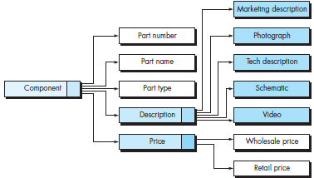
Content Model for WebApps
WebApp that supports SafeHome is established at www.safehomeassured.com
Use case - Purchasing Select SafeHome Components
Data tree created for a www.safehomeassured.com component
Simple or composite data items are represented as unshaded rectangles.
Content objects are represented as shaded rectangles
Objects would be further refined as the data tree expands

Slide 96
Interaction Model for Web and Mobile Apps
A“conversation” between an end user and application functionality, content, and behavior can be described using an interaction model that can be composed of one or more of the following elements:
(1) use cases, (2) sequence diagrams, (3) state diagrams and/or (4) user interface prototypes
A set of use cases is sufficient to describe the interaction at an analysis level
when the sequence of interaction is complex and involves multiple analysis classes or many tasks, it is sometimes worthwhile to depict it using a more rigorous diagrammatic form
Because WebApp construction tools are plentiful, relatively inexpensive, and functionally powerful, it is best to create the interface prototype using such tools.

Slide 97
Functional Model for WebApps
Many WebApps deliver a broad array of computational and manipulative functions that can be associated directly with content and that are often a major goal of user-WebApp interaction
Functional requirements must be analyzed, and when necessary, modeled
The functional model addresses two processing elements of the WebApp, each representing a different level of procedural abstraction:
user-observable functionality that is delivered by the WebApp to end users
the operations contained within analysis classes that implement behaviors associated with the class

Slide 98
Functional Model for WebApps
User-observable functionality encompasses any processing functions that are initiated directly by the user
may actually be implemented using operations within analysis classes
but from the point of view of the end user, the function is the visible outcome
At a lower level of procedural abstraction, the requirements model describes the processing to be performed by analysis class operations
These operations manipulate class attributes and are involved as classes collaborate with one another to accomplish some required behavior.
Regardless of the level of procedural abstraction, the UML activity diagram can be used to represent processing details

Slide 99
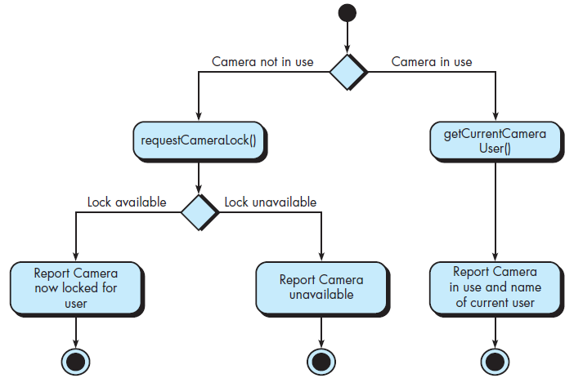
Functional Model for WebApps
use case Control cameras for www.safehomeassured.com
activity diagram for the takeControlOfCamera() operation that is part of the Camera analysis class used within the Control cameras
two additional operations are invoked with the procedural flow:
requestCameraLock() - tries to lock the camera for this user,
getCurrentCameraUser() - retrieves the name of the user who is currently controlling the camera
Notes:
the interaction
is relatively simple, but there is the potential for complex functionality,
given that this “simple” operation requires complex communication with devices
located remotely and accessible across the Internet. A further possible complication
relates to negotiation of control when multiple authorized people attempt
to monitor and/or control a single sensor at the same time.

Slide 100
Configuration Model - overview
Server-side
Server hardware and operating system environment must be specified
Interoperability considerations on the server-side must be considered
Appropriate interfaces, communication protocols and related collaborative information must be specified
Client-side
Browser configuration issues must be identified
Testing requirements should be defined

Slide 101
Configuration Models for WebApps
In some cases, the configuration model is nothing more than a list of server-side and client-side attributes
However, for more complex WebApps, a variety of configuration complexities (e.g., distributing load among multiple servers, caching architectures, remote databases, multiple servers serving various objects on the same Web page) may have an impact on analysis and design
The UML deployment diagram can be used in situations in which complex configuration architectures must be considered
Specify interoperability with existing product databases and monitoring applications

Slide 102
Navigation Modeling
It considers how each user category will navigate from one WebApp element to another
Questions asked and answered for overall navigation requirements analysis :
• Should certain elements be easier to reach (require fewer navigation steps) than others? What is the priority for presentation?
• Should certain elements be emphasized to force users to navigate in their direction?
• How should navigation errors be handled?
• Should navigation to related groups of elements be given priority over navigation to a specific element?
• Should navigation be accomplished via links, via search-based access, or by some other means?
• Should certain elements be presented to users based on the context of previous navigation actions?
• Should a navigation log be maintained for users?
• Should a full navigation map or menu be available at every point in a user’s interaction?
• Should navigation design be driven by the most commonly expected user behaviors or by the perceived importance of the defined WebApp elements?
• Can a user “store” his previous navigation through the WebApp to expedite future usage?
• For which user category should optimal navigation be designed?
• How should links external to the WebApp be handled? Overlaying the existing browser window? As a new browser window? As a separate frame?

Slide 103
Summary: Elements of the Analysis Model
Object-oriented Analysis
Structured Analysis
Scenario-based
modeling
Flow-oriented
modeling
Use case text
Use case diagrams
Activity diagrams
Swim lane diagrams
Data flow diagrams
Control-flow diagrams
Processing narratives
Class-based
modeling
Behavioral
modeling
Class diagrams
Analysis packages
CRC models
Collaboration diagrams
State diagrams
Sequence diagrams
☺

